Slide 1
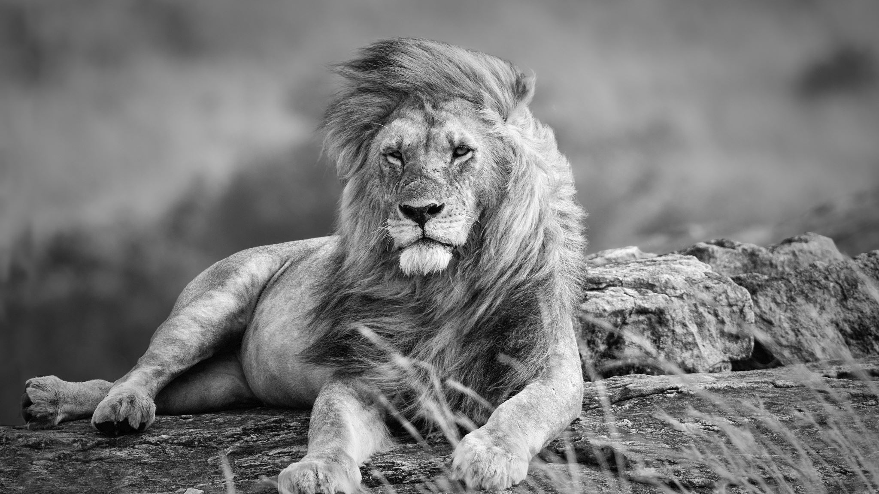
Blue Ridge Lions Club
The month in Review
And what’s ahead
November 10, 2022

Slide 2
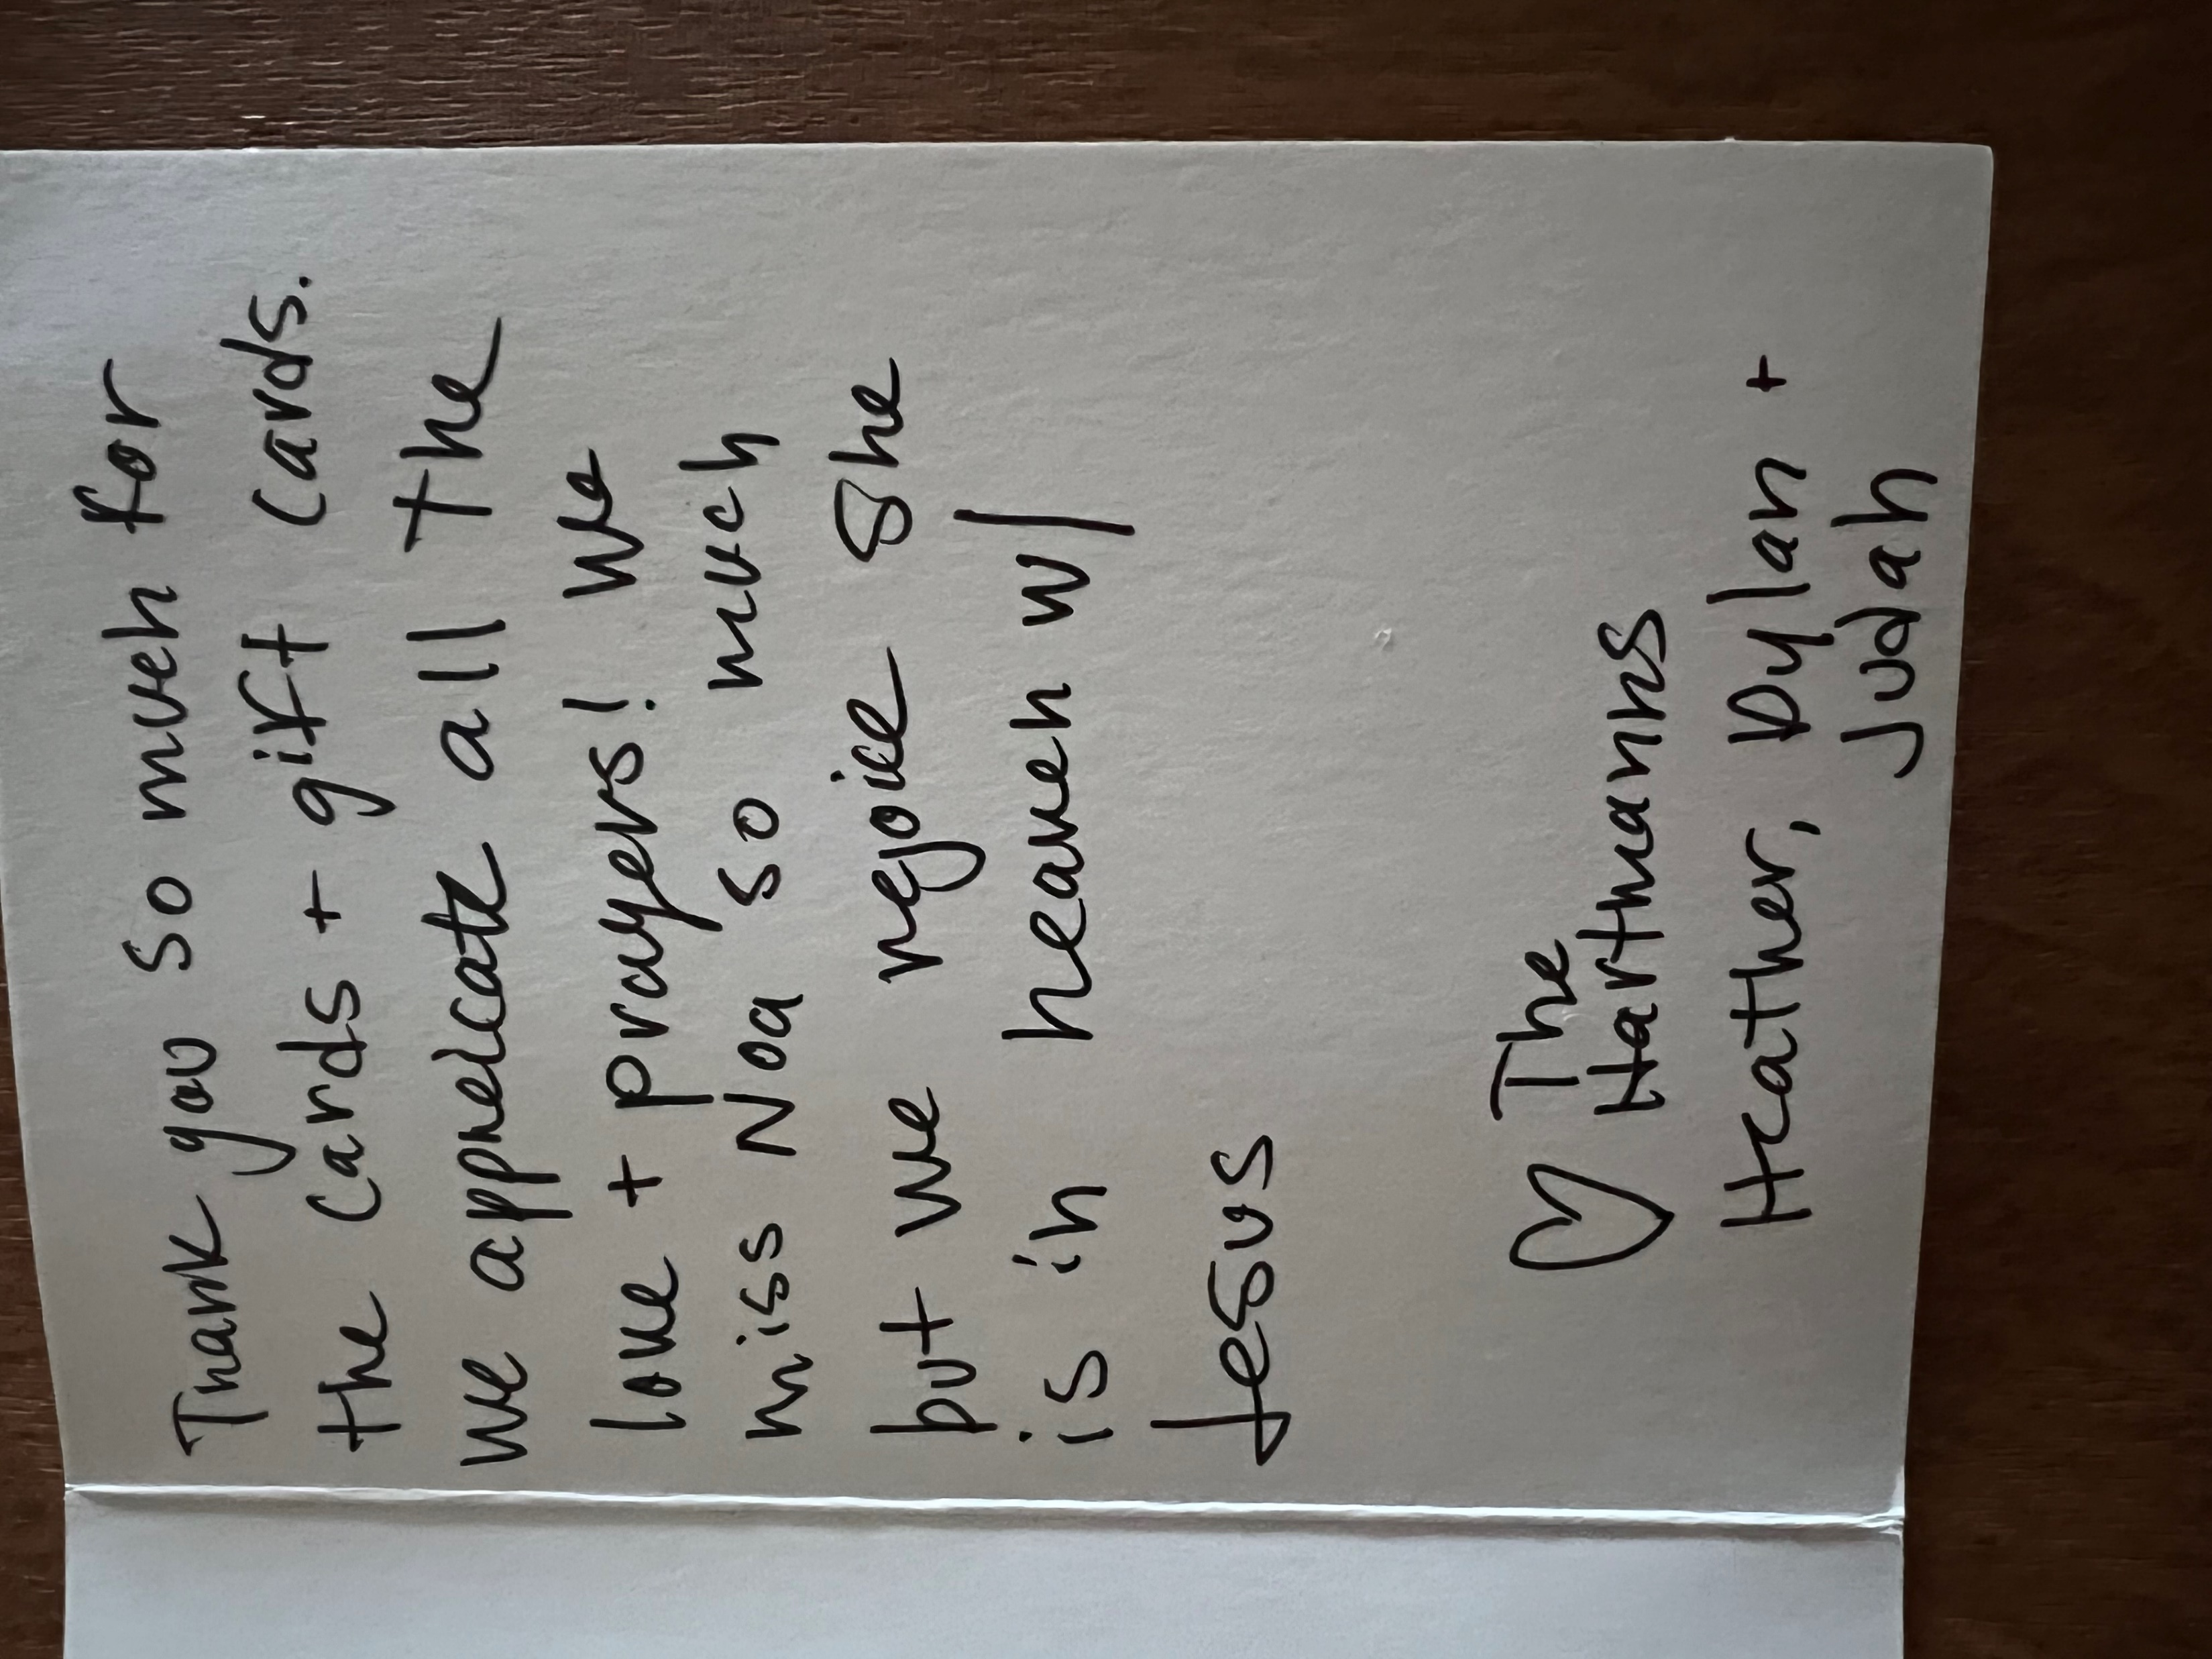
Thank you card from the family we gave to during Childhood Cancer Month.

Slide 3
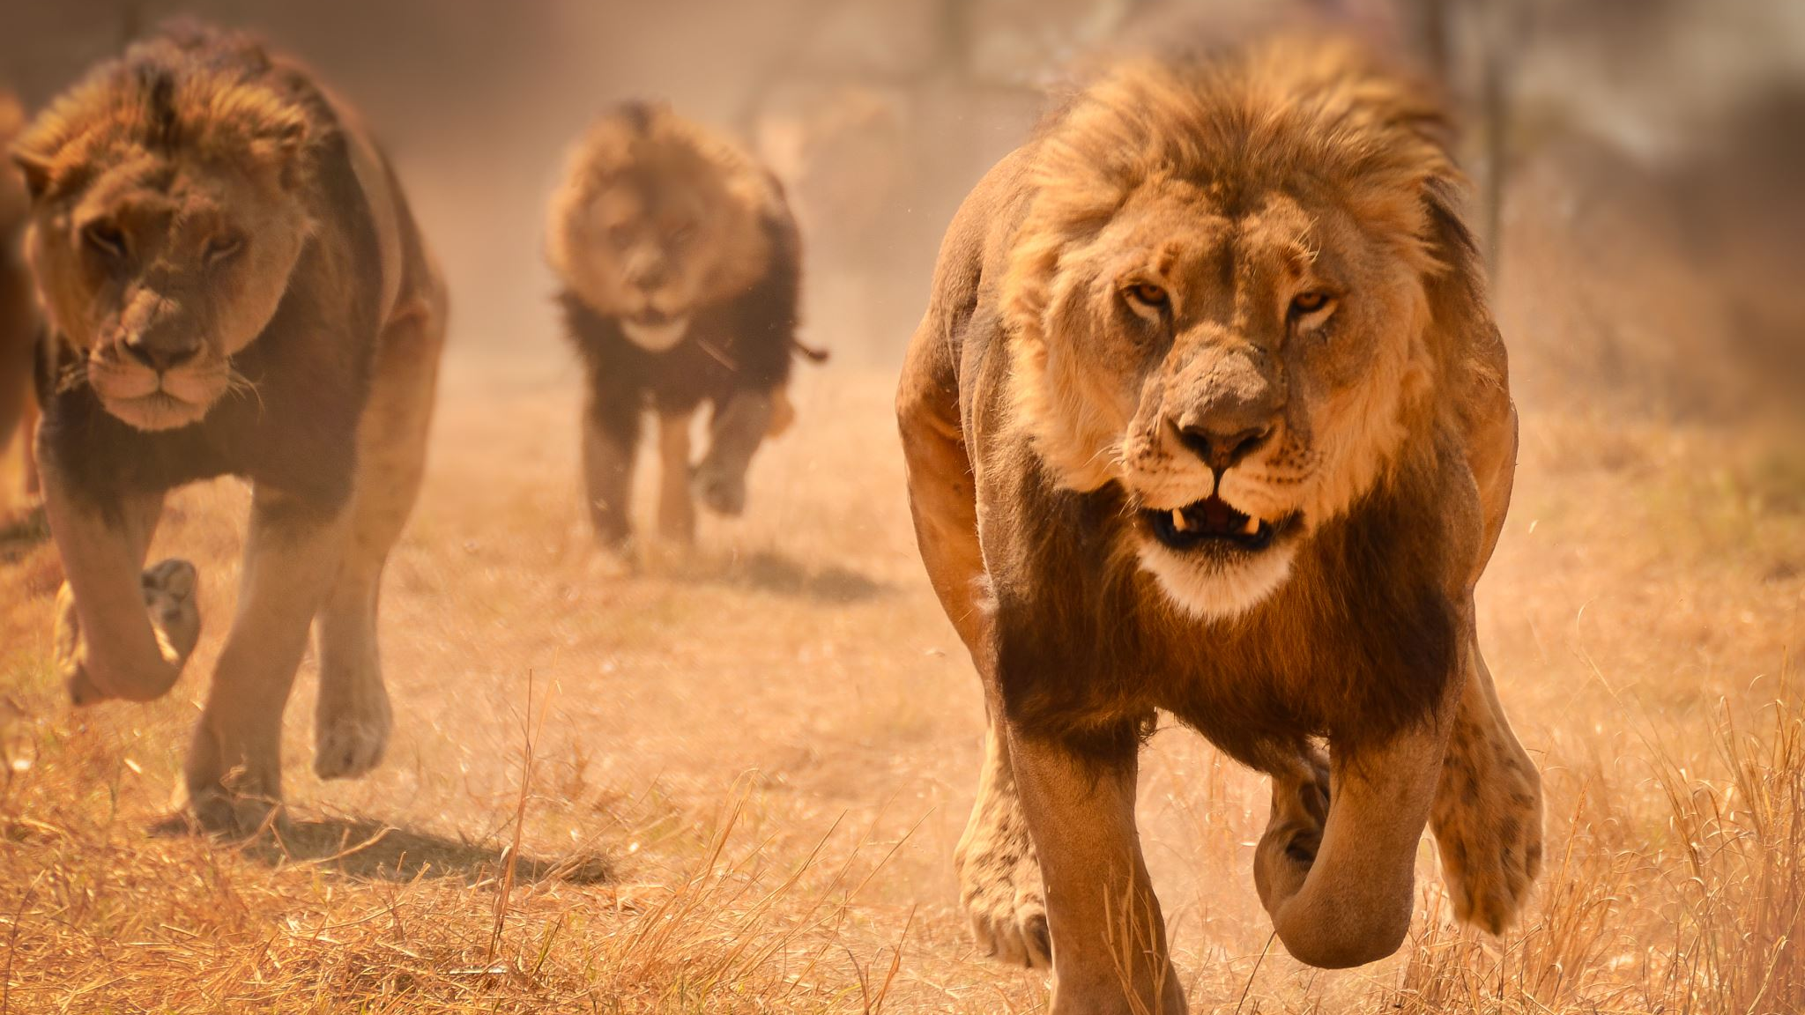
Your Lions have been busy
Attending meetings around the district….

Slide 4
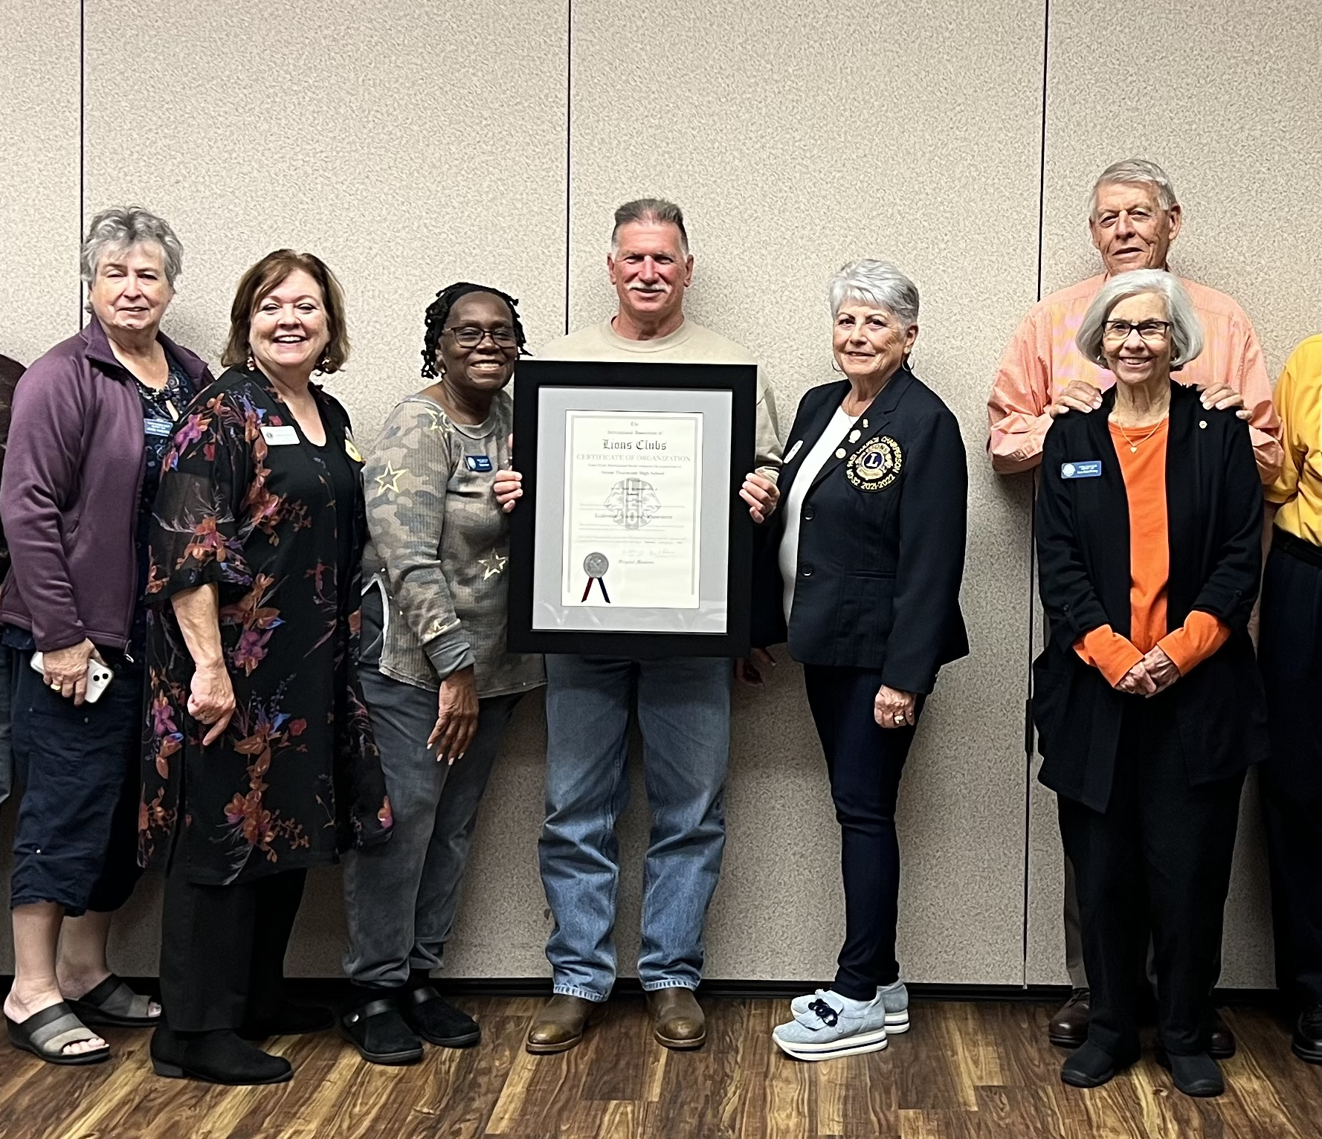
Lion Hope met with the Aiken Lions Club to celebrate chartering a LEO club and to talk about membership.

Slide 5
Lion Hope and Lion Jim had a great time talking with the Lexington Latino Club Branch.

Slide 6
Lions Trent and Angela noticed a Melvin Jones Plaque in a leather shop in Florence, Italy recently. Lions are everywhere. Here they are pictured with Lion Niki Guash. She gave them a 50% discount just for being Lions.

Slide 7
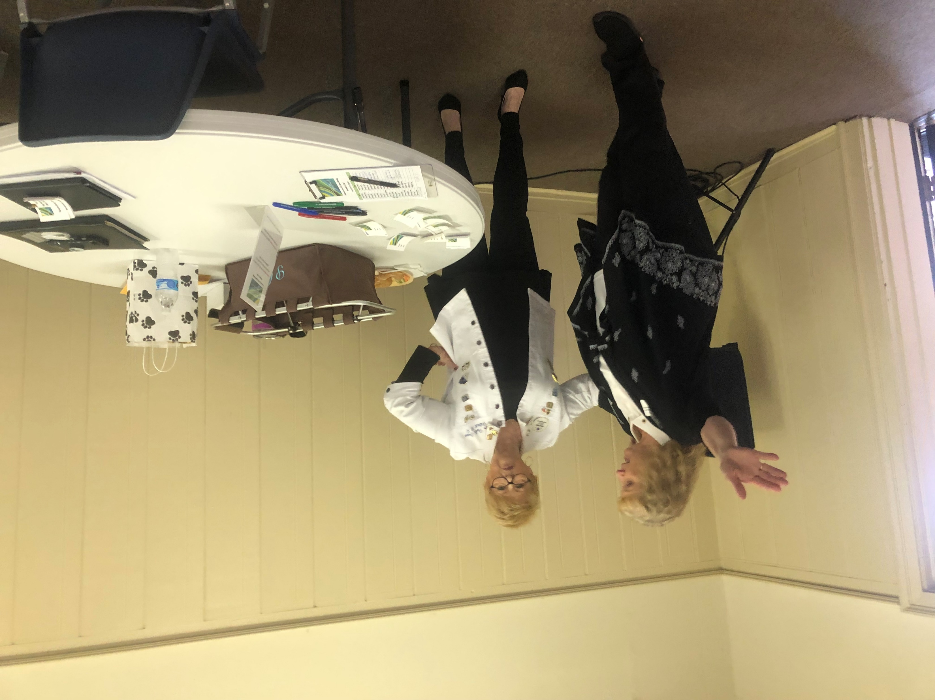
District Cabinet Meeting
Lions Paula, Jim and Hope attended the District Cabinet Meeting in Anderson.

Slide 8
Lion Jim pins Lion Joe Robinson of the Greenville Pleasantburg Lions Club with the Lions Vision Services Franklin Mason Fellow pin. Joe is the longest serving current member of the club.

Slide 9
Blue Ridge Lions serve!! Eye Screening Event Tigerville

Slide 10
Belk Charity Sale to raise money for charitable causes.

Slide 11
Remember:
Greer Christmas Parade Sunday December 4 2:30 pm
Gap Creek Singers Friday December 9, 7 pm. No meeting December 8
Concessions Double Springs Saturdays December-February
Scholarship Fundraising December Facebook (Go Fund Me)

